Slide 1
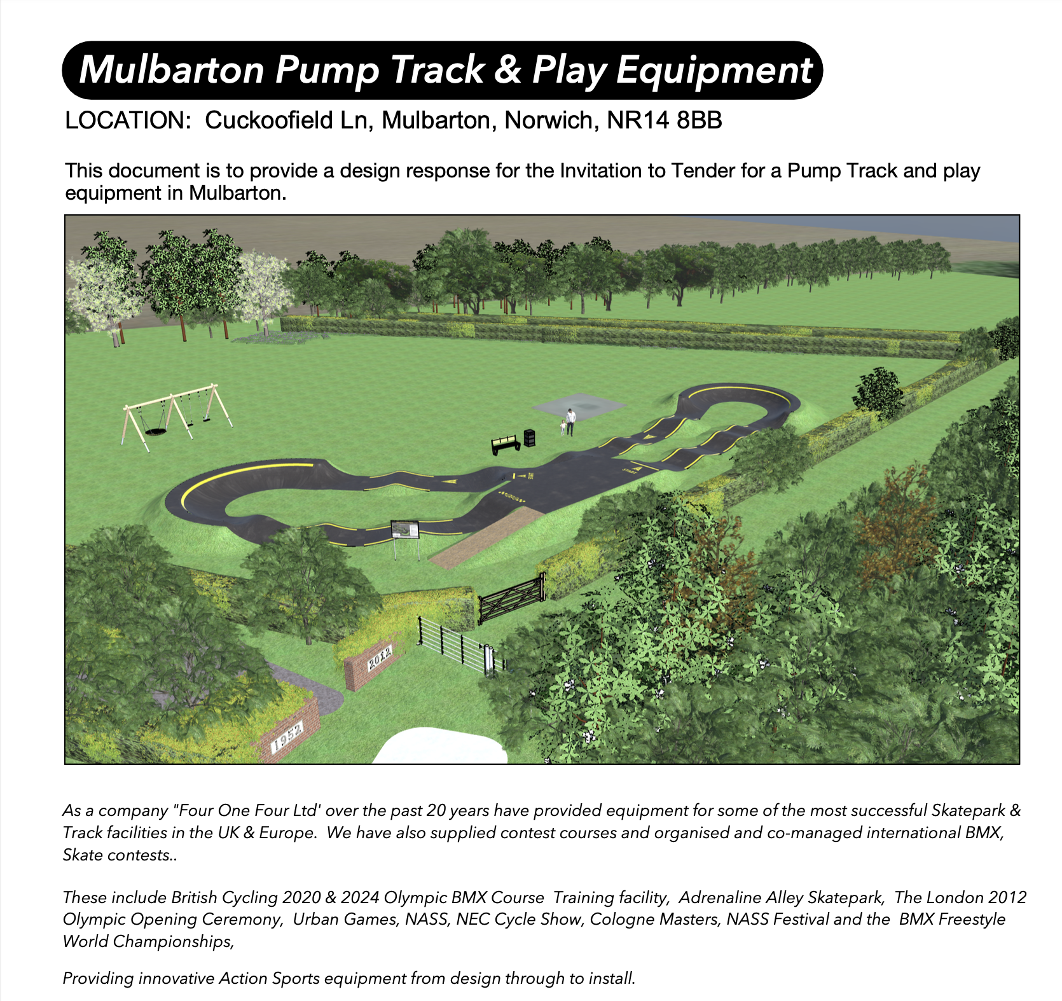


Slide 2
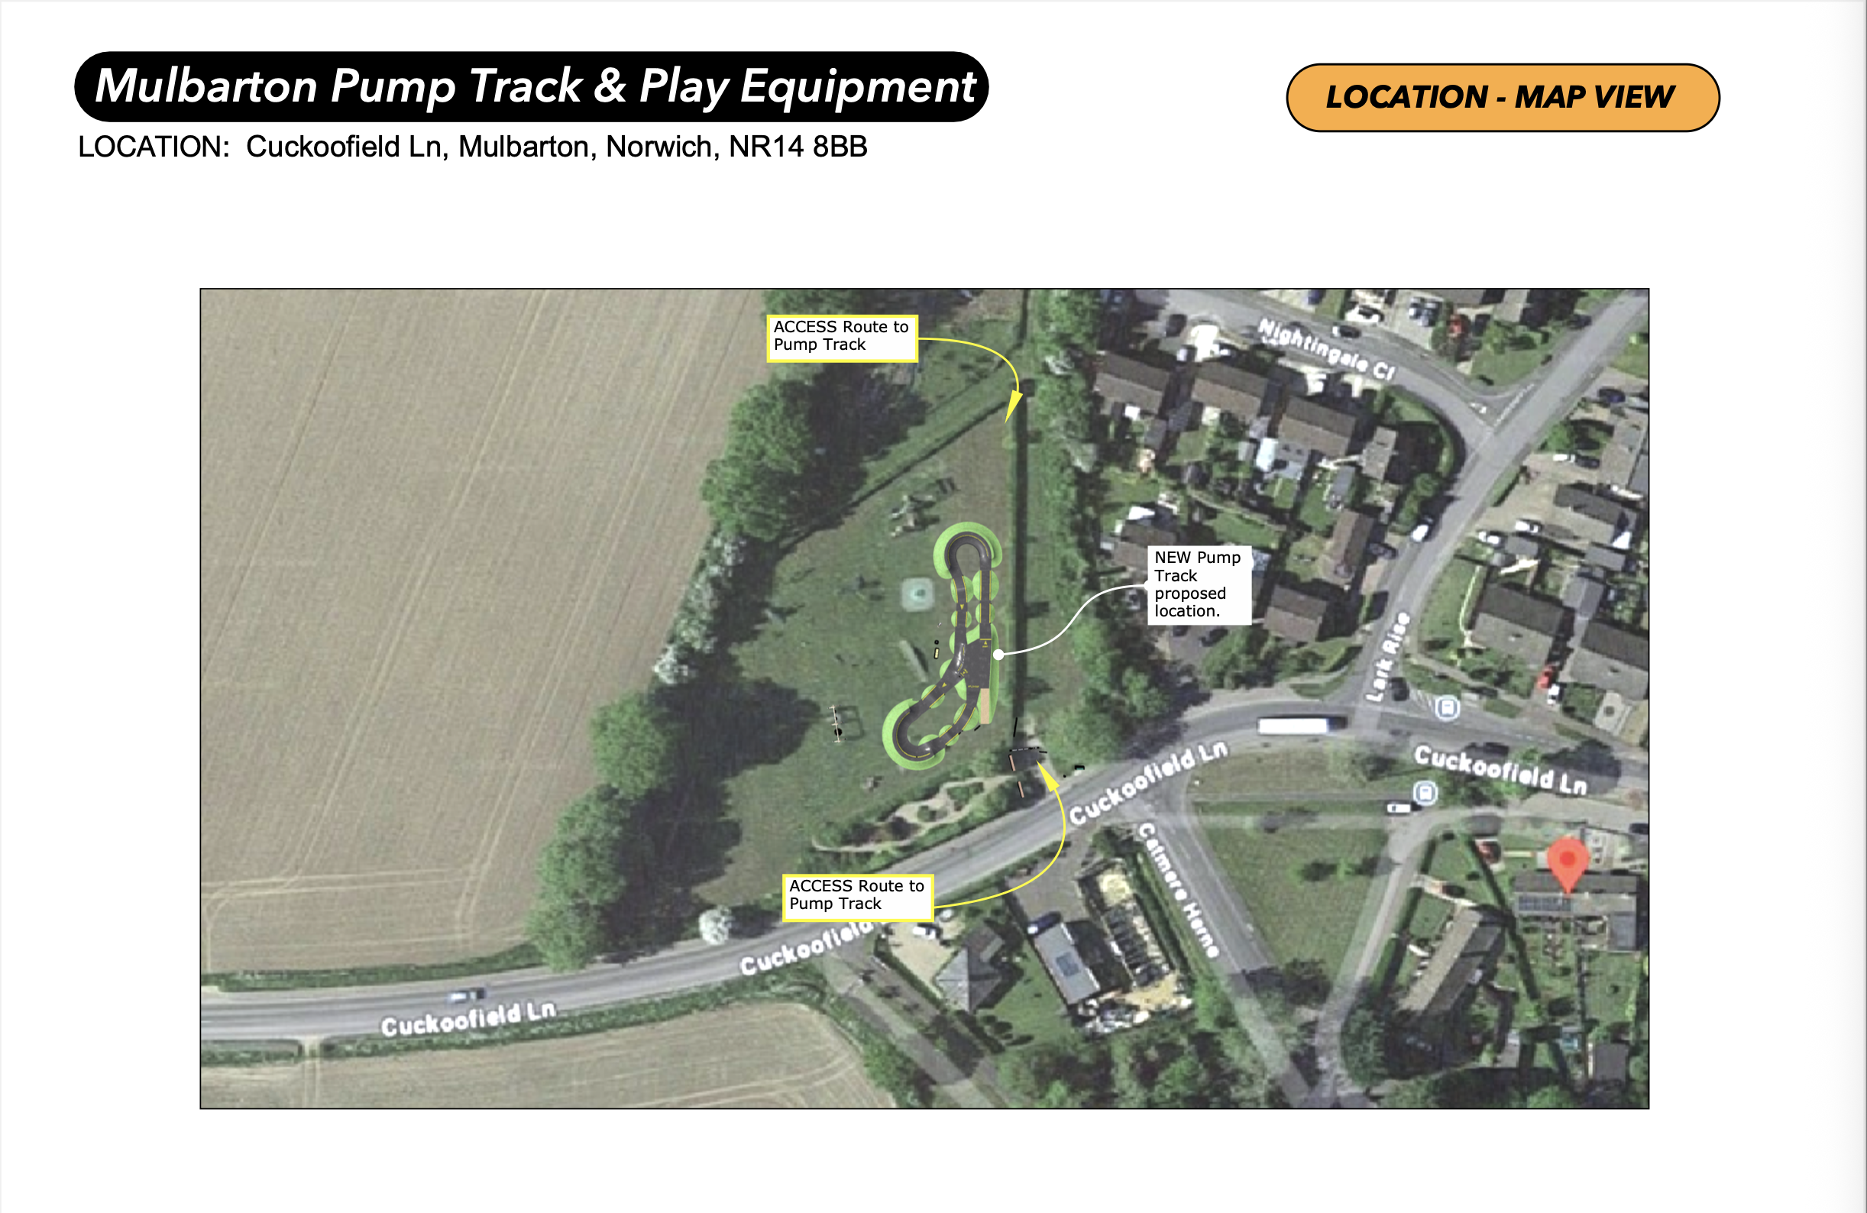

Slide 3
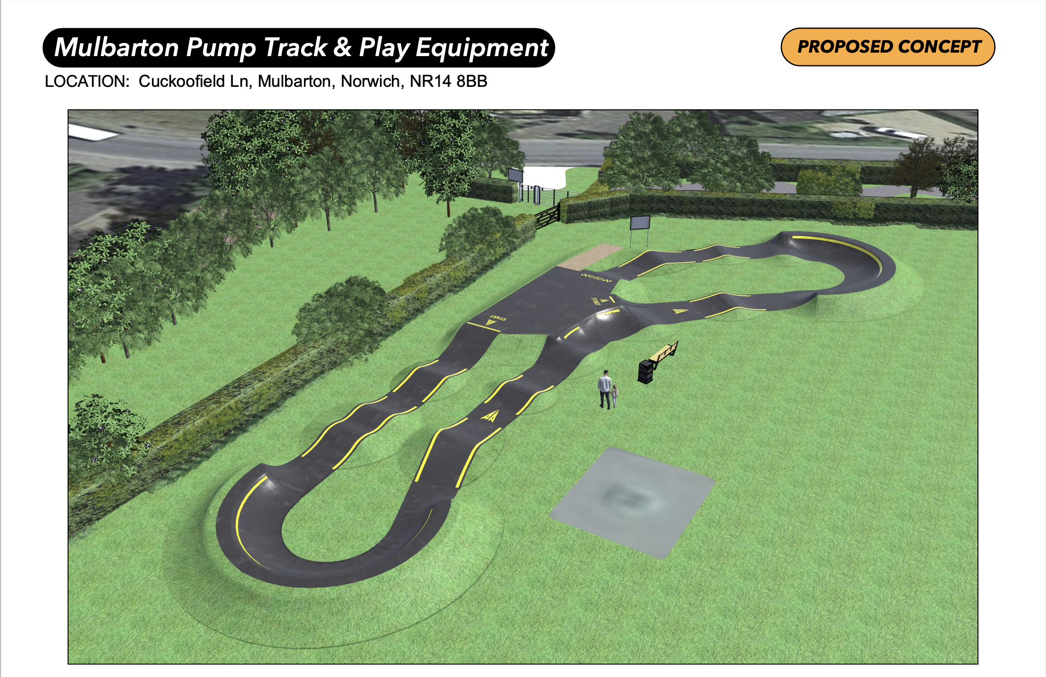

Slide 4
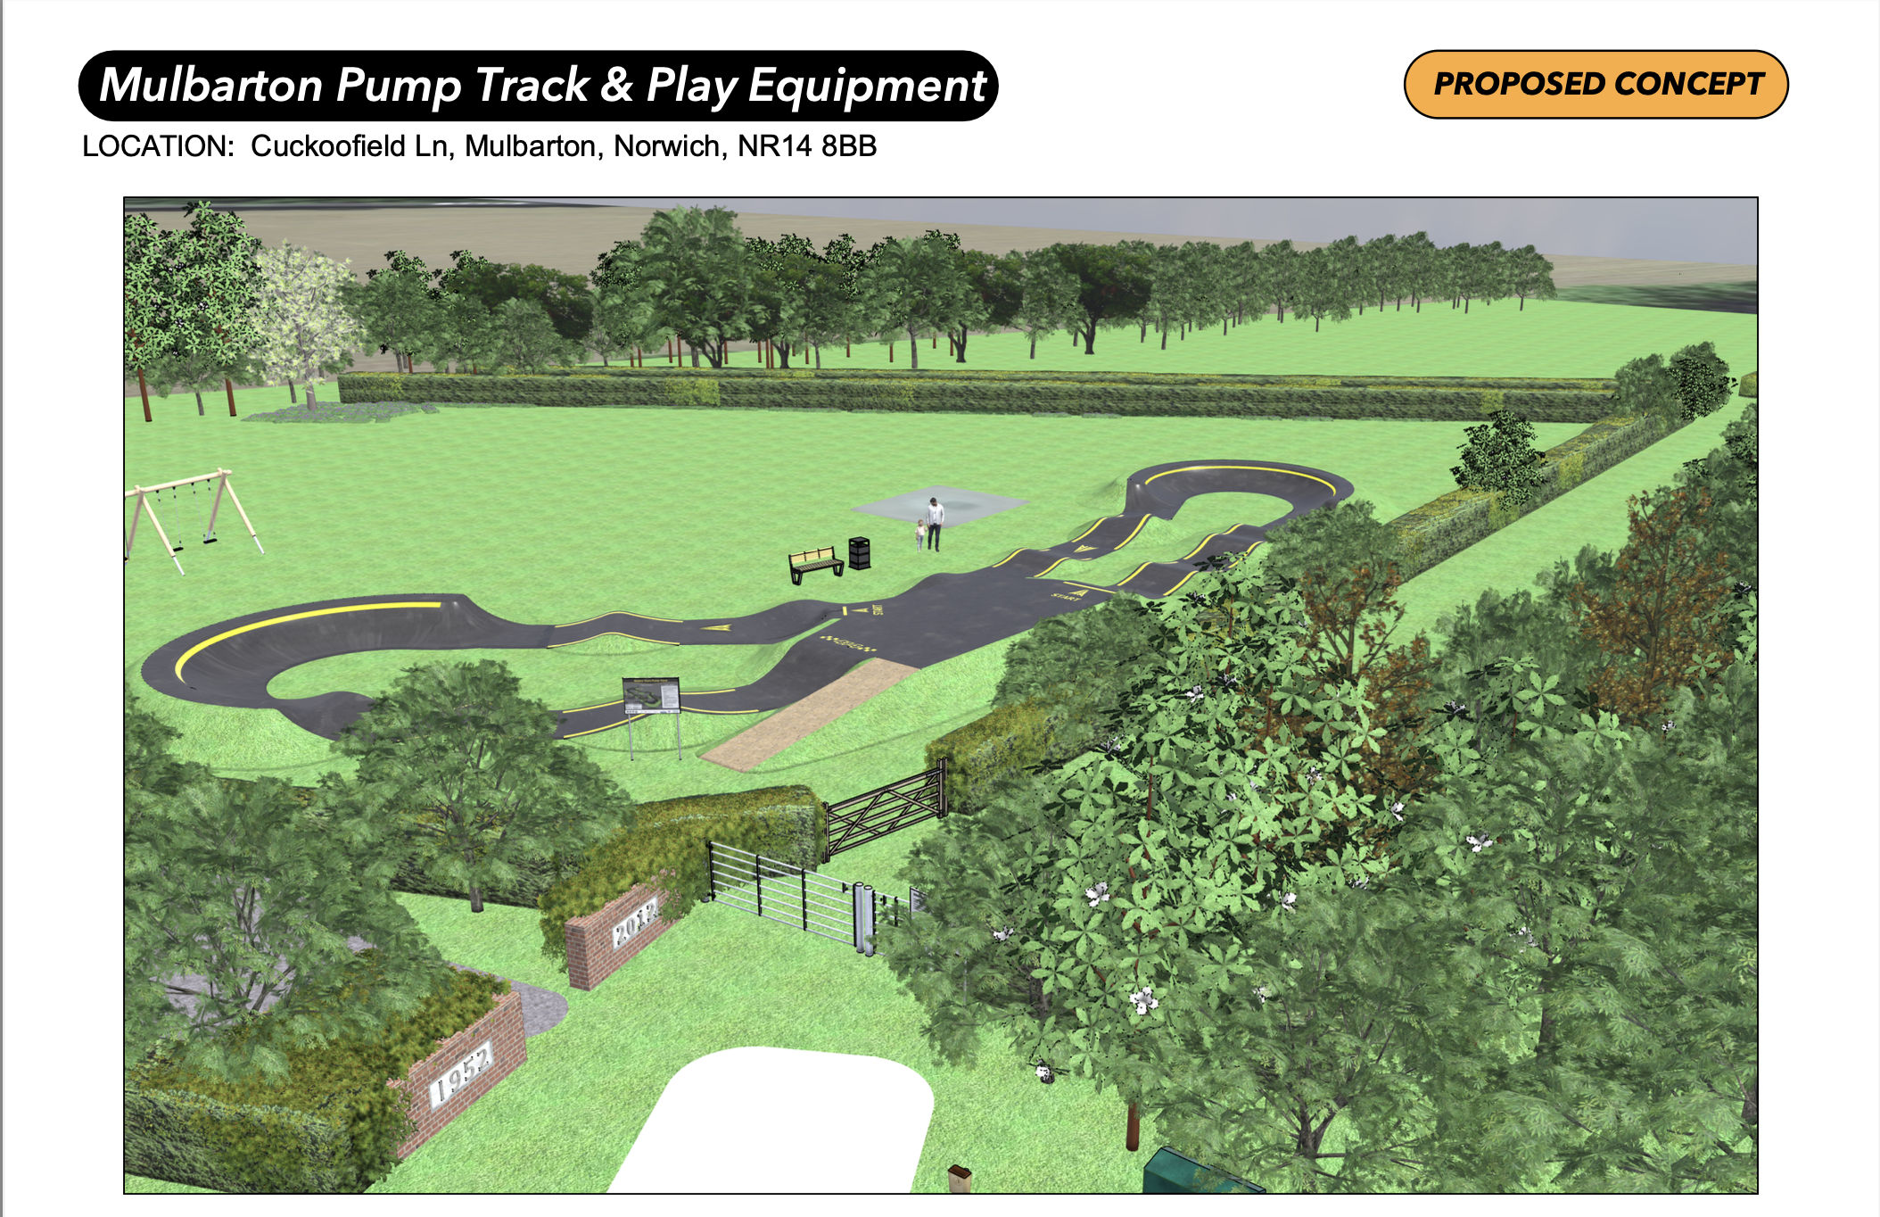

Slide 5
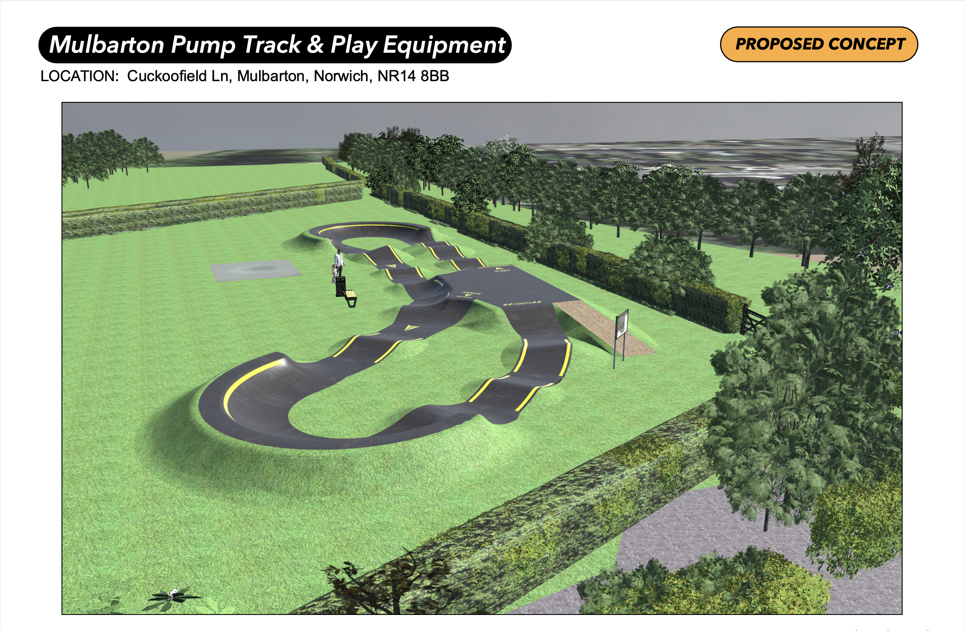

Slide 6
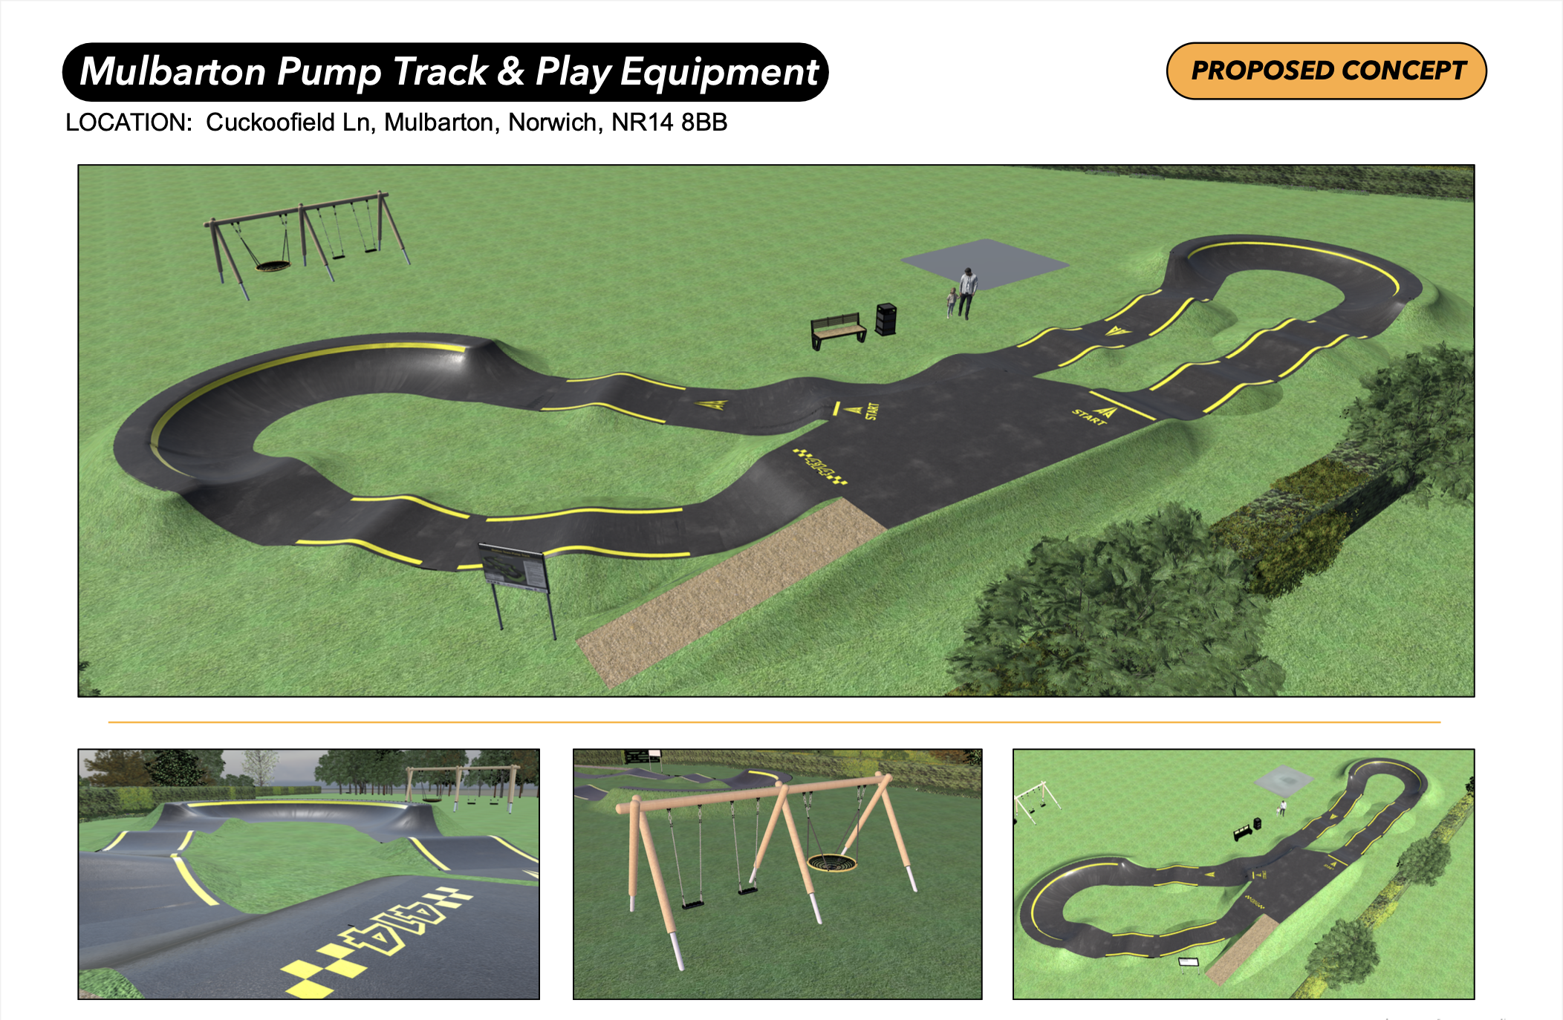

Slide 7
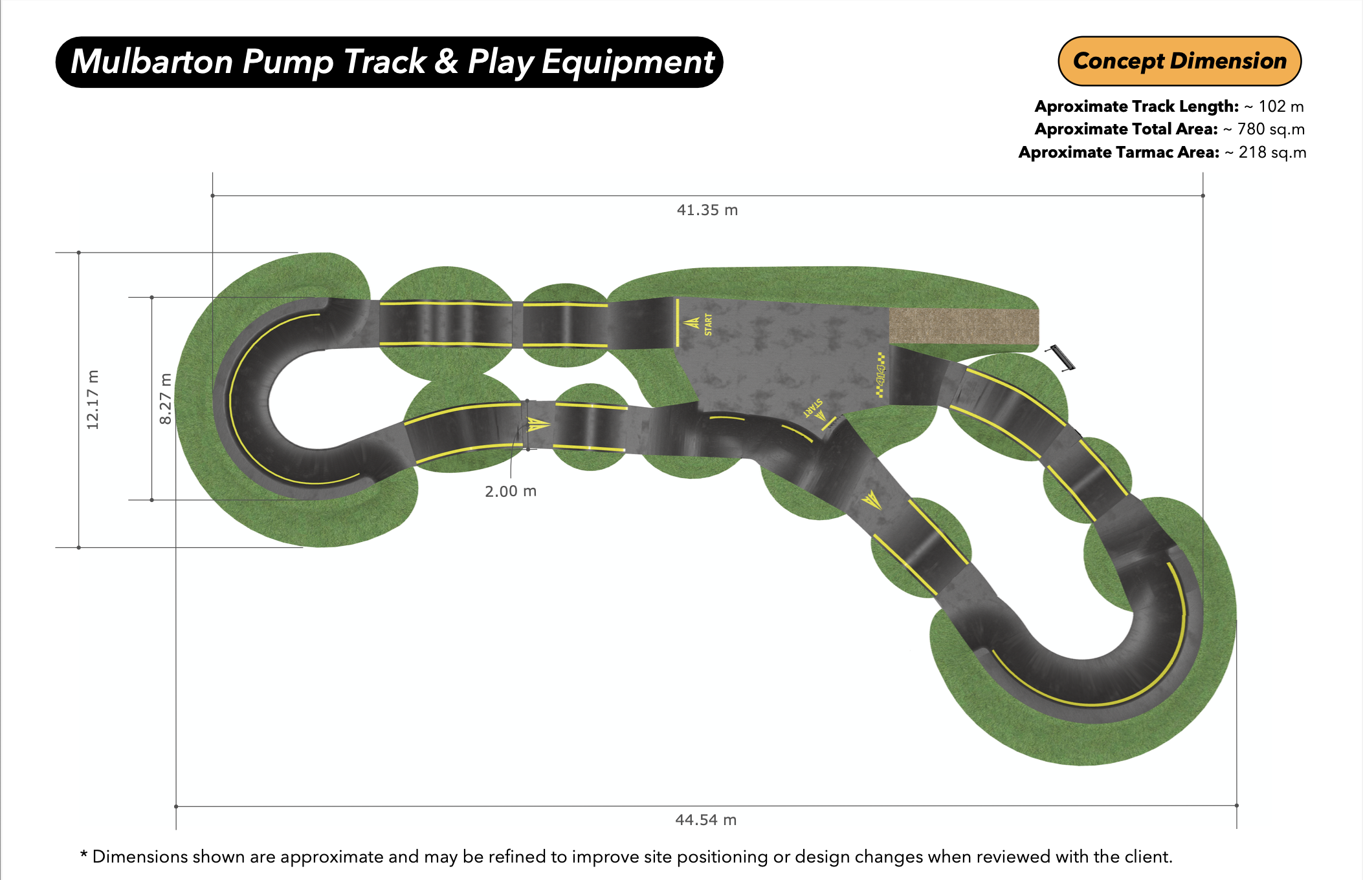

Slide 8


Slide 9
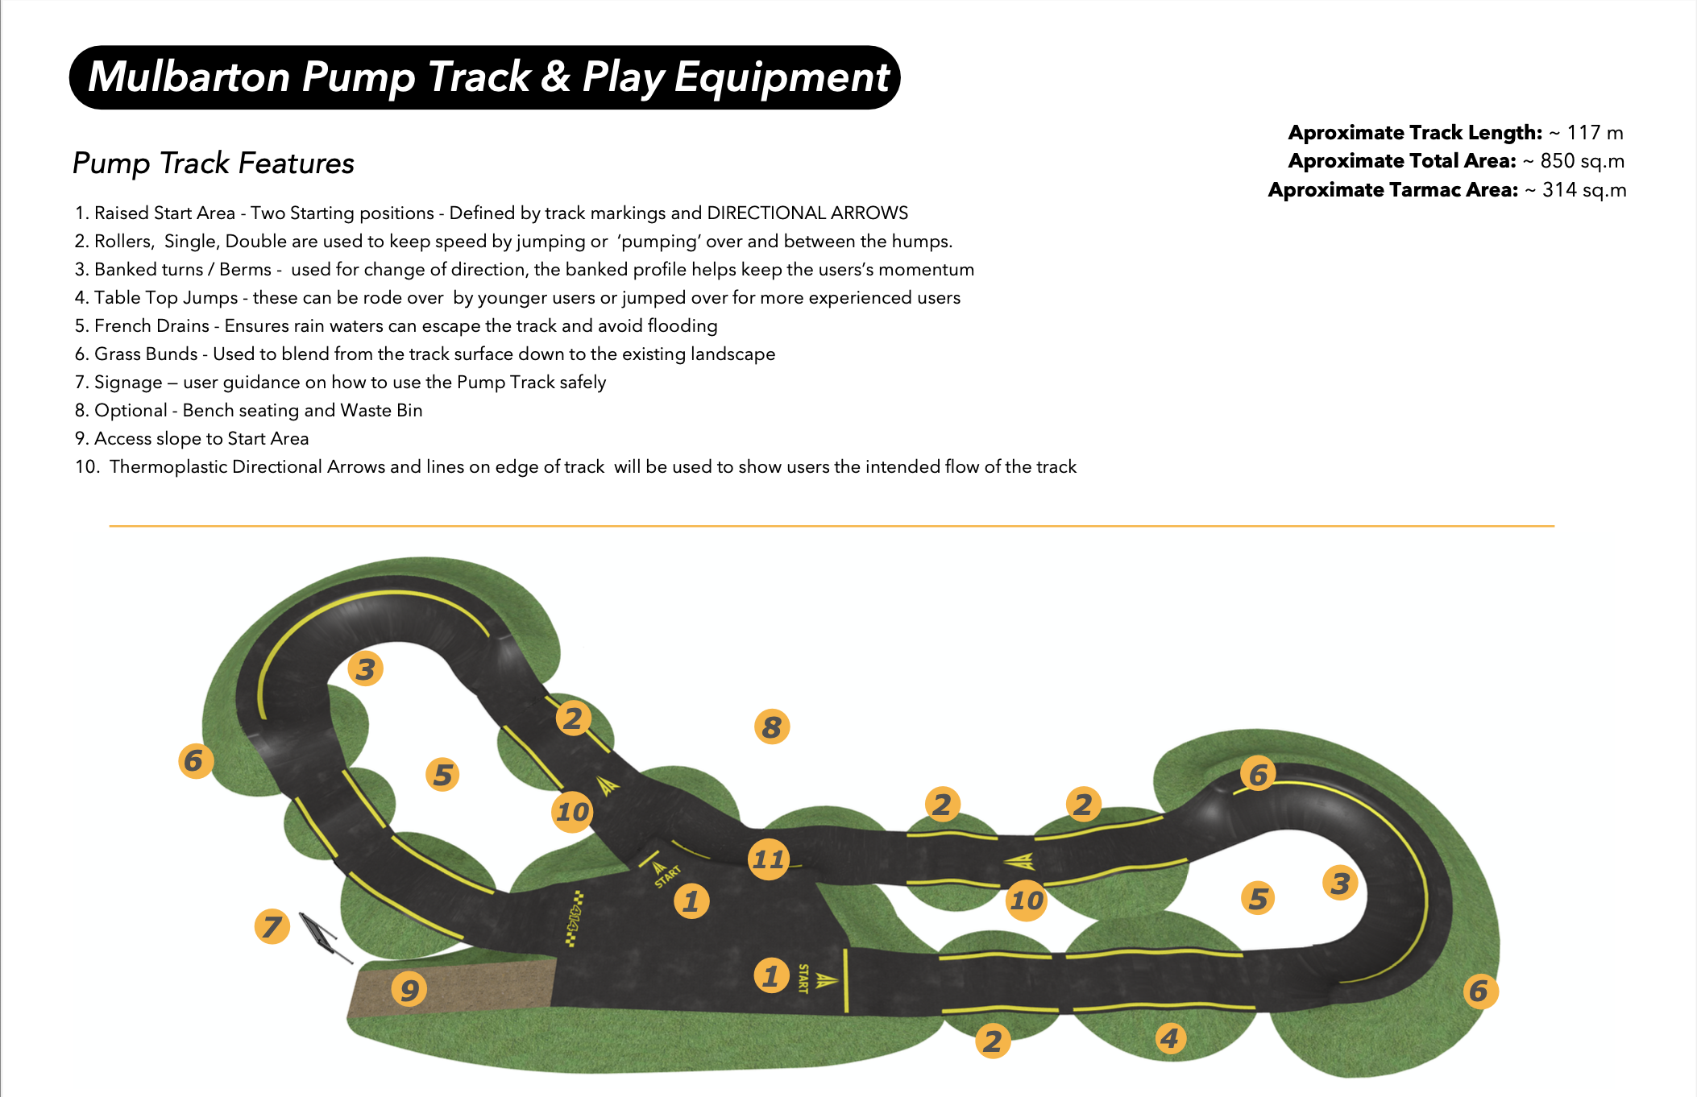

Slide 10
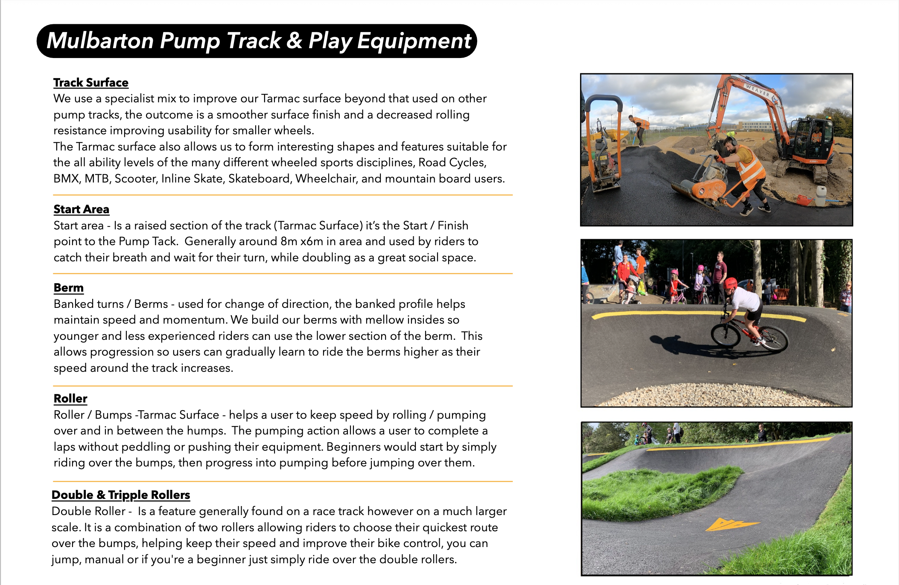

Slide 11
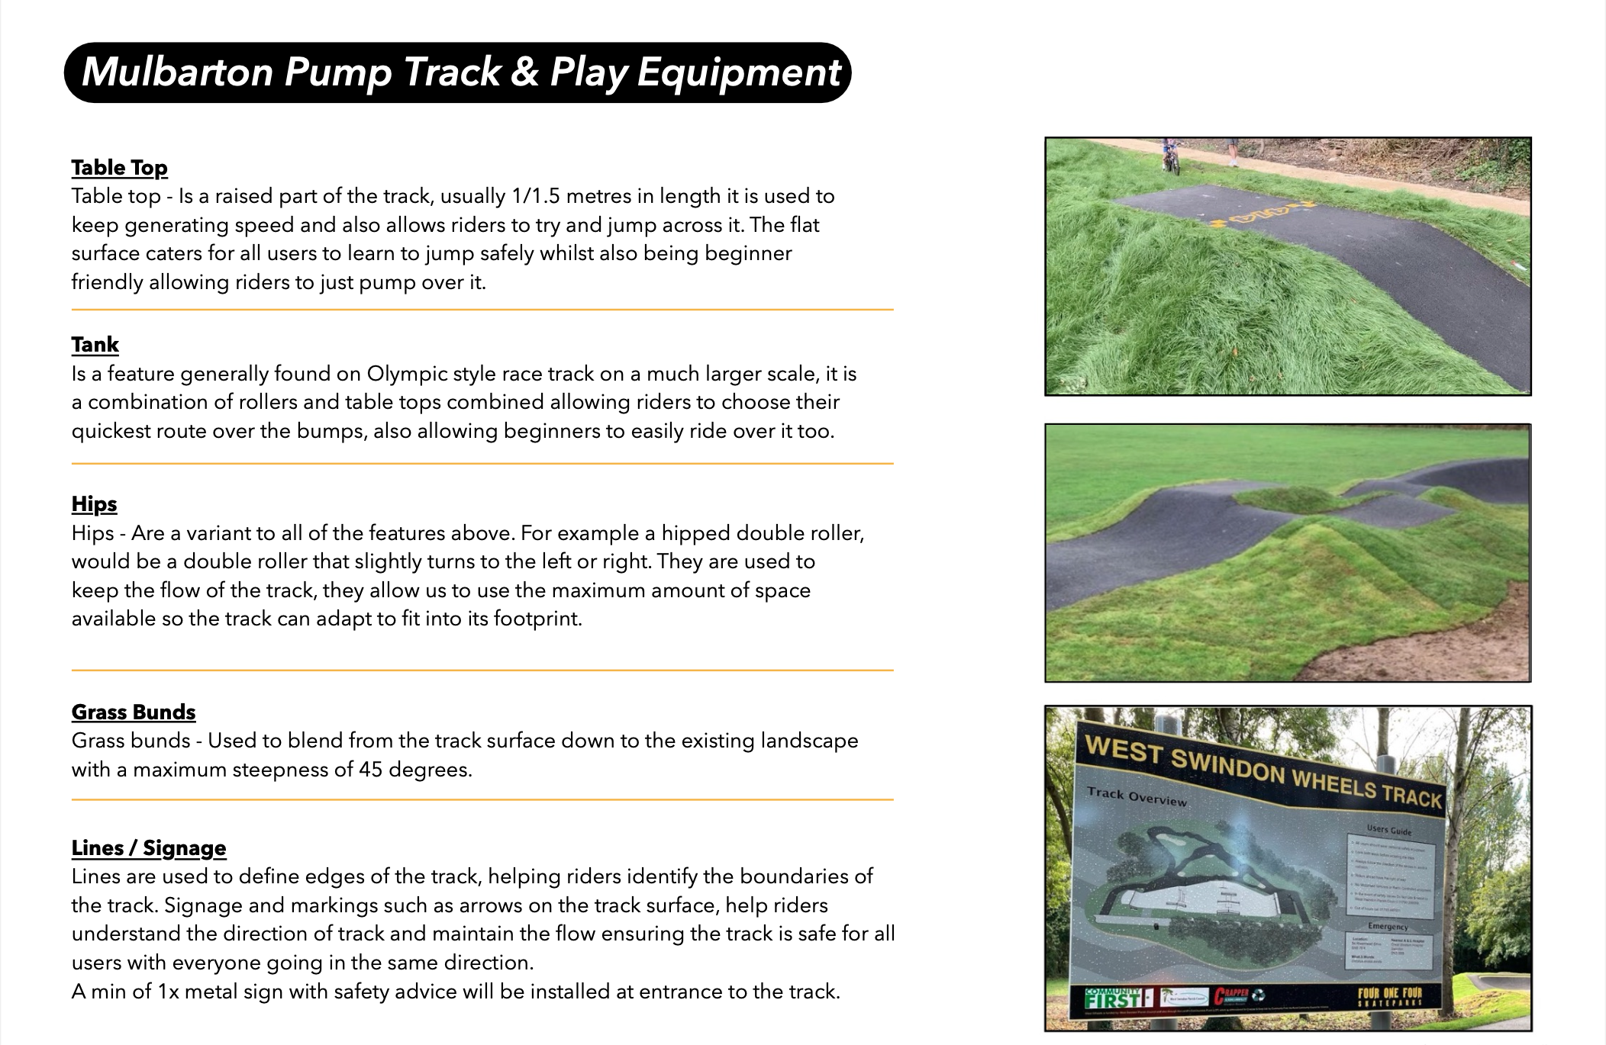

Slide 12
Thank You for Your Time
We appreciate the opportunity to share our vision for the new pump track.
Our goal is to create a space that inspires riders of all ages and abilities, encourages healthy activity, and brings the community together.
If you have any questions, we’d love to answer them.
Four One Four Ltd

